Slide 1
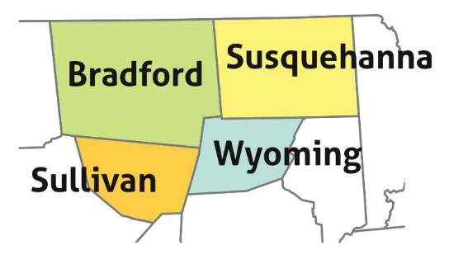
The Endless Mountains Heritage Region’s
2023 Partnership/Mini-Grants Program

Slide 2
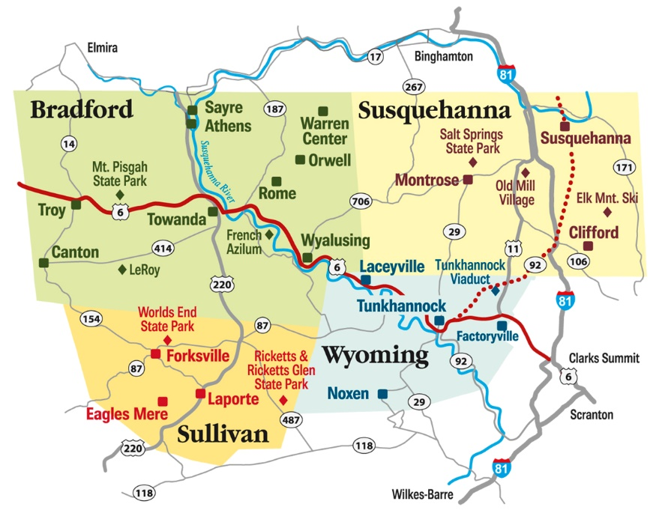
What is the EMHR?
Established in 1998, the EMHR is celebrating 25 years in 2023!
We are a 501c3 non-profit, membership-based organization. It is one of 12 current Heritage Areas in Pennsylvania designated by the Department of Conservation and Natural Resources (DCNR) and serves a 2,850-square mile area encompassing Bradford, Sullivan, Susquehanna and Wyoming Counties.
Through the DCNR’s financial support and its Mini-Grants Program, the EMHR has brought nearly $3 million in state funding (matched by another $3 million) into the region to perform projects related to historic preservation, outdoor recreation development and conservation (parks, greenways and water trails), scenic enhancements (murals and overlook projects), educational programming, as well as certain agricultural support initiatives and building rehabilitations for museums and historical societies.

Slide 3
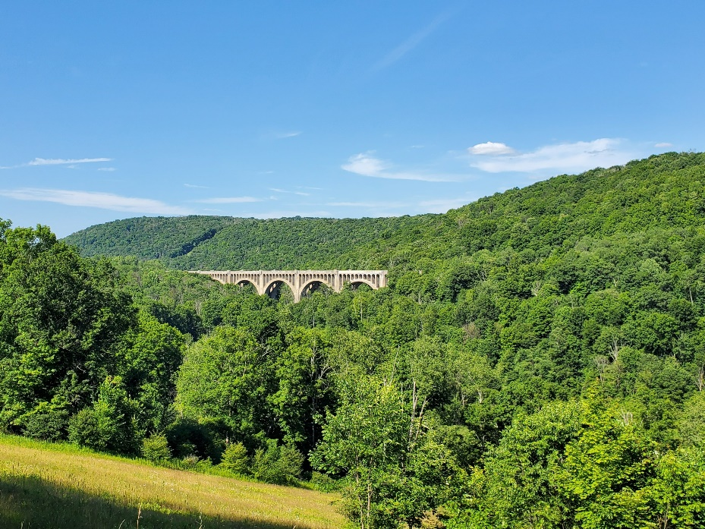
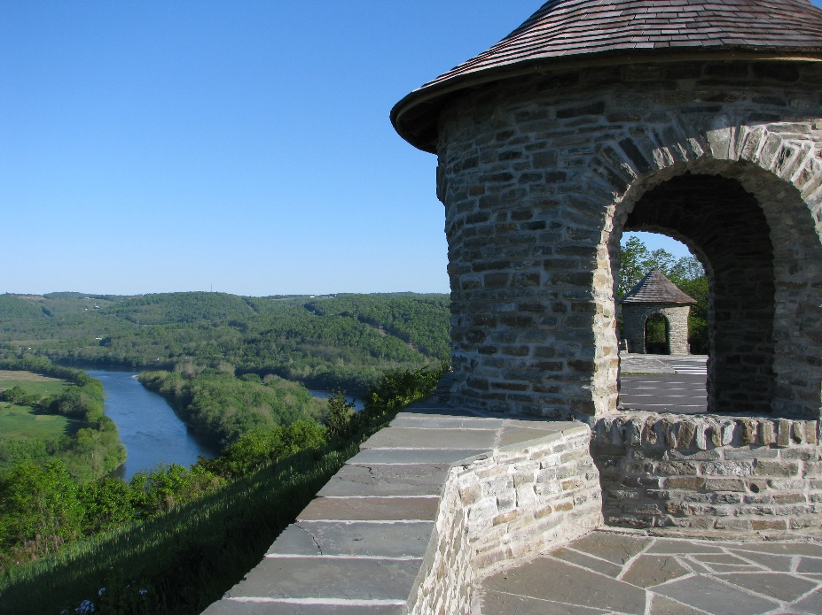
Mini-Grant Guidelines
$65,000 in grant funding available in Round 28.
Grant requests must be between $500 and $10,000.
All grants must be matched at a minimum ratio of 1:1 (full match required).
Eligible matches include cash matches, in-kind matches (volunteer time) or a combination of the two.

Slide 4
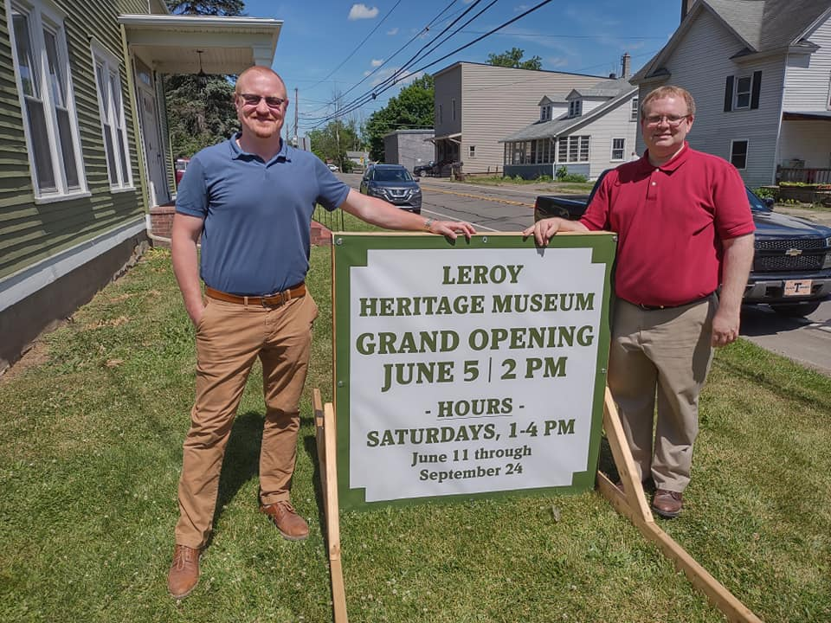
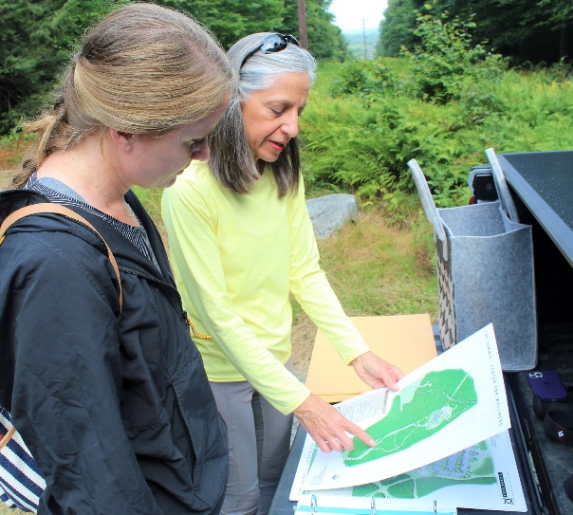
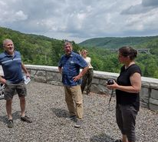
Mini-Grant Guidelines
All applicants MUST be paying members of the EMHR (Forms are available at: emheritage.org/membership).
Each applicant is limited to submitting two grant applications.
Contracts begin June 5, 2023. All projects should be completed by Sept. 2, 2024.
Extensions are available, if necessary

Slide 5
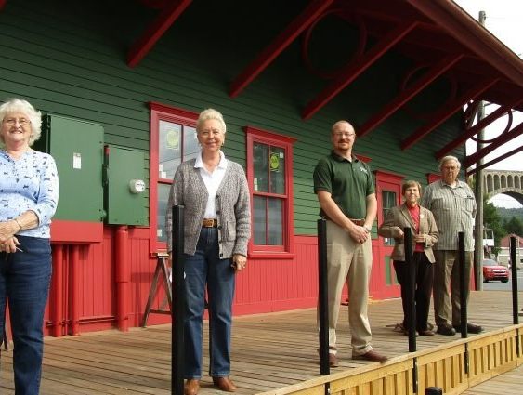
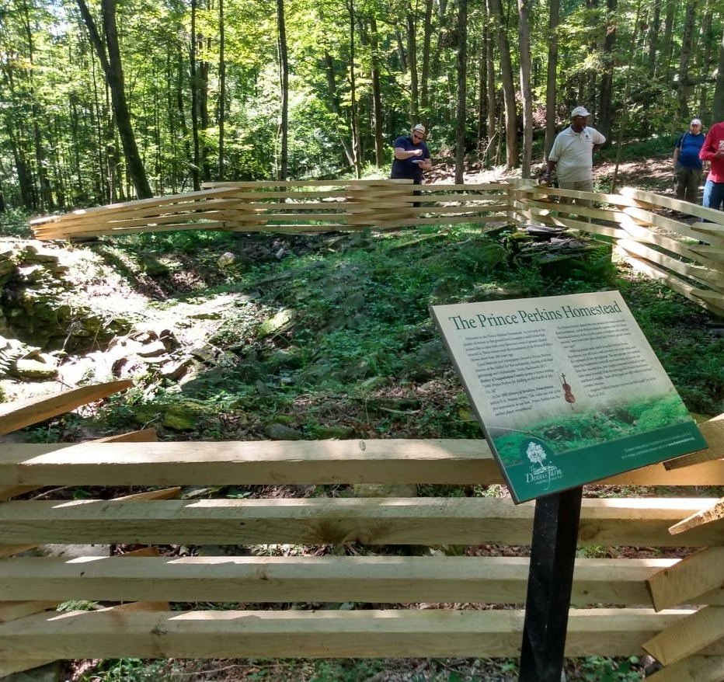
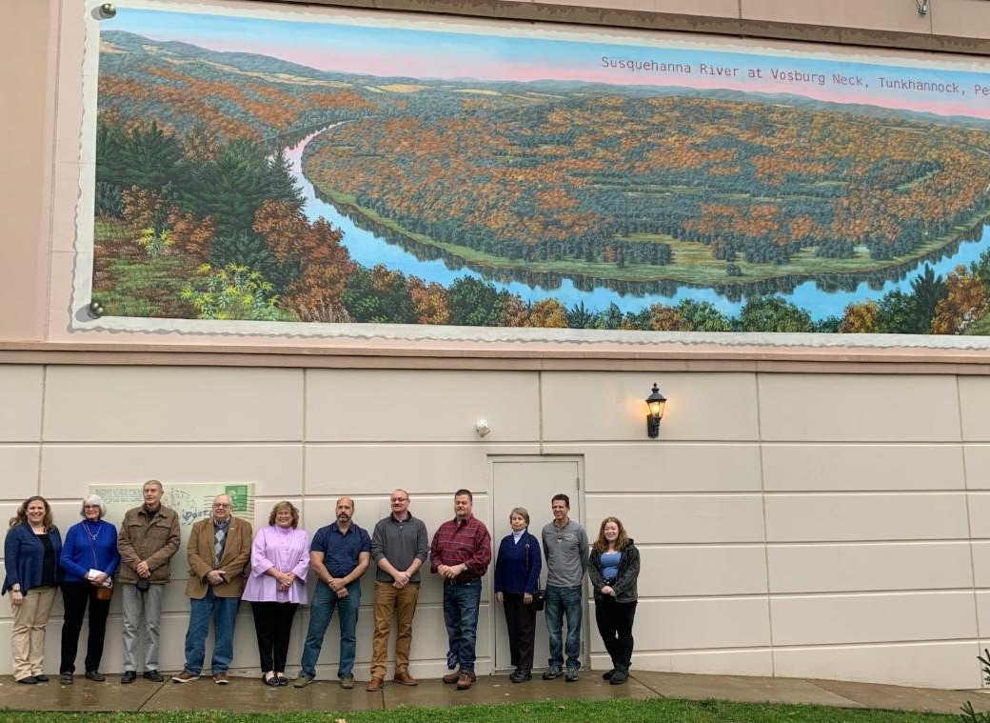
Eligible Mini-Grant Applicants
501(c)3 Non-profit organizations (Must have BCO #).
Counties we serve.
Municipalities and municipal agencies in those counties.
Public education institutions.
Must be based within or serve the EMHR’s four-county region.

Slide 6
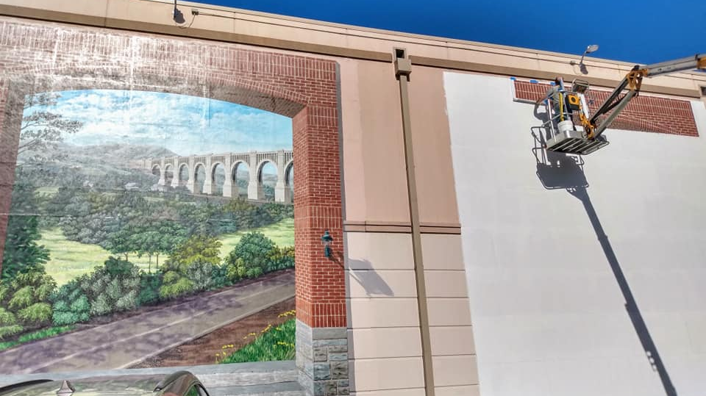
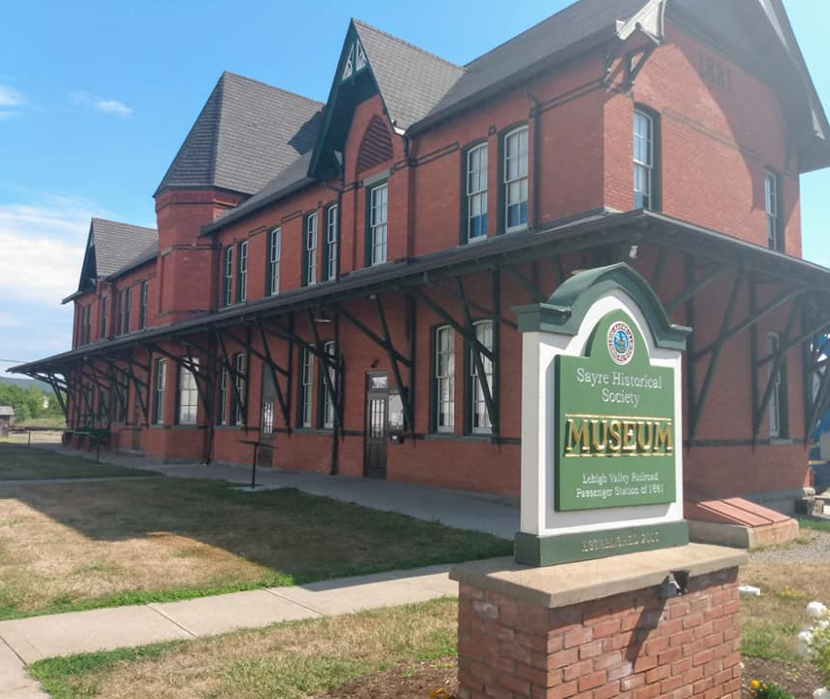
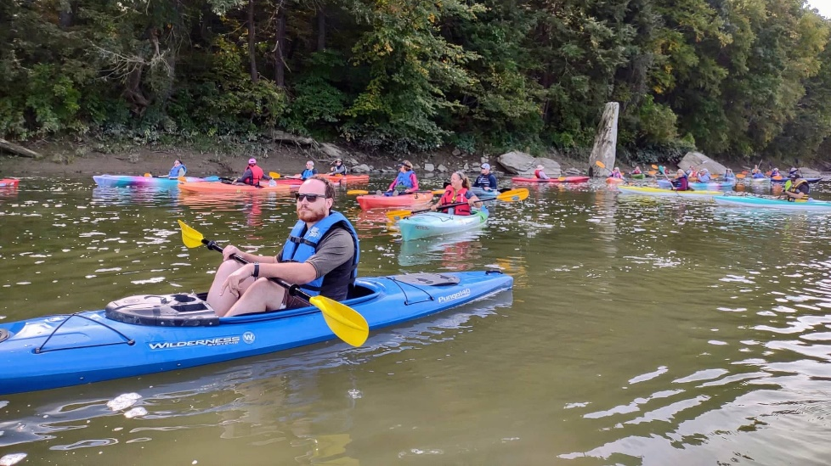
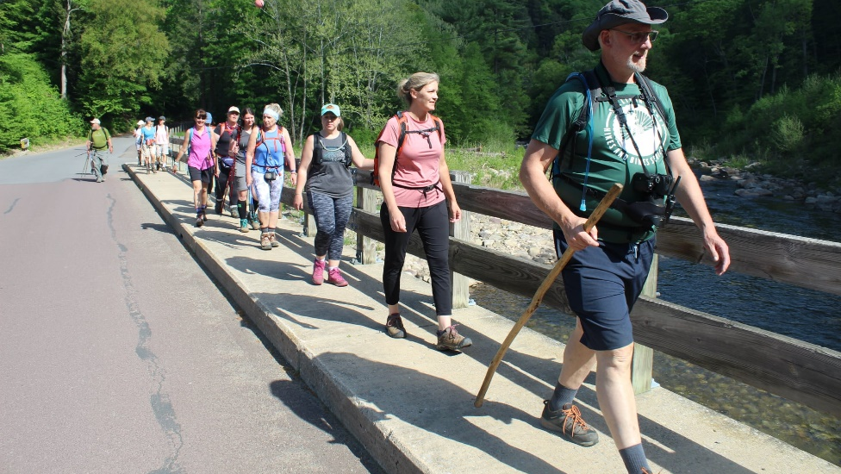
Suitable Projects
The EMHR seeks to fund projects pertaining to:
Historic preservation (must be public venue)
Outdoor recreation development (parks, greenways, land and water trails, scenic overlooks, etc.)
Special purpose studies for regional trails, parks, museums, etc.
Educational programming pertaining to nature, agriculture, outdoor rec, regional history, etc.
Environmental conservation initiatives
Certain building rehabilitation projects for museums, historical societies, etc.
Interpretive and wayfinding signage for outdoor rec sites

Slide 7
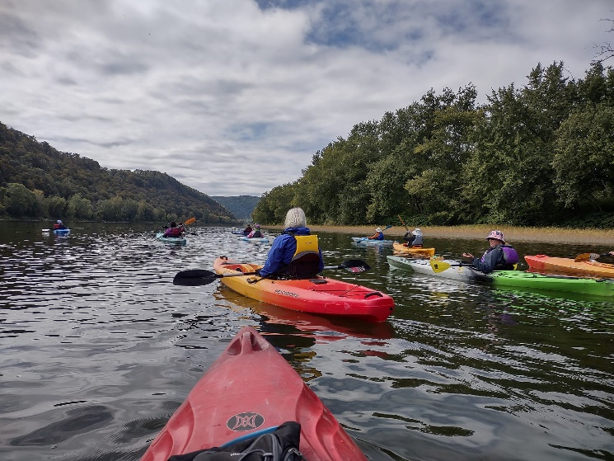
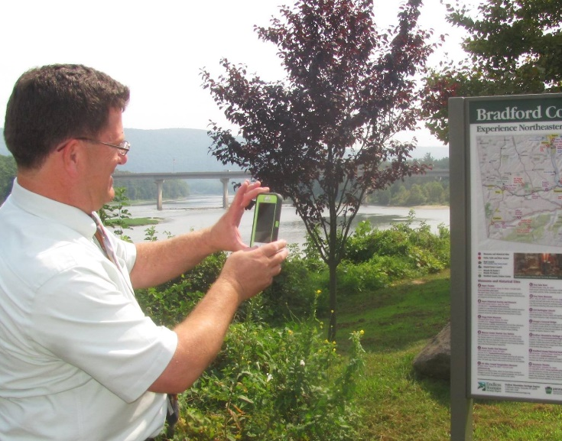
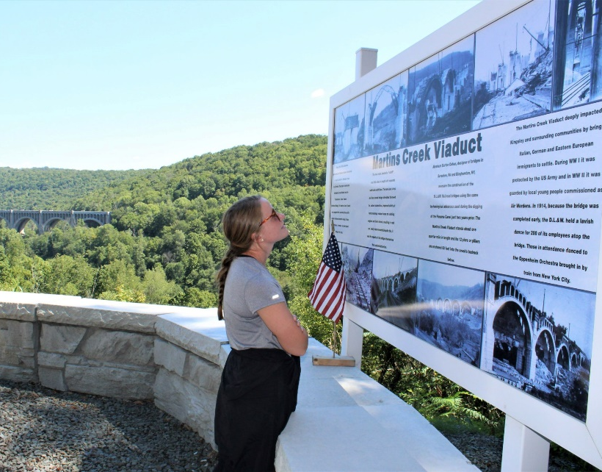
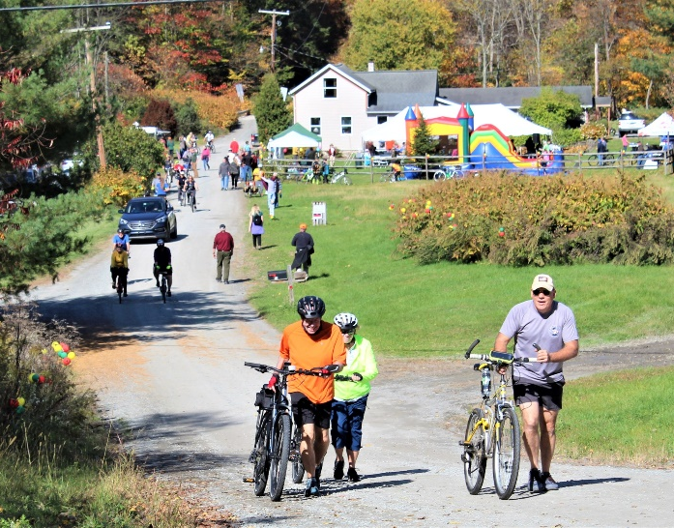
Suitable Projects
Projects should further the EMHR’s mission and goals outlined in its newly updated and adopted 2022-26 Management Action Plan (MAP). All found on application cover page available at www.emheritage.org/grant-forms
Mission:
“To celebrate, preserve and enhance the rural character and culture of the Endless Mountains Heritage Region.”
Goals:
Attract visitors to the Region’s communities, heritage sites, outdoor recreation opportunities, and downtowns to strengthen the local economy.
Protect and enhance our heritage assets, cultural landscapes and natural features where the Heritage Region’s stories can be told.
Engage residents and visitors with the Region’s culture and heritage through educational programming, events and tourism promotion.
Offer a wide range of heritage and outdoor recreation destinations and activities for all ages and abilities.
Preserve and promote agricultural growth and deliver authentic experiences of “Living with the Land” in the Endless Mountains.

Slide 8
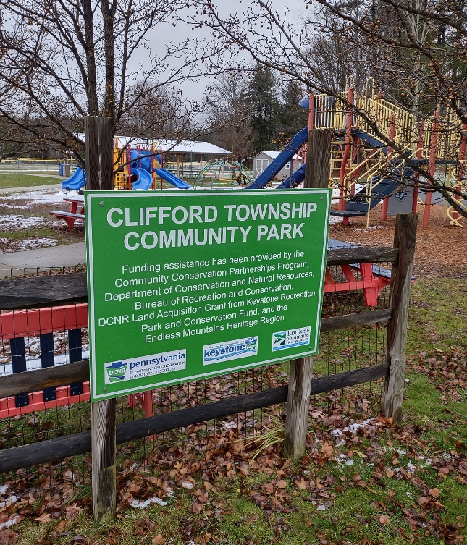
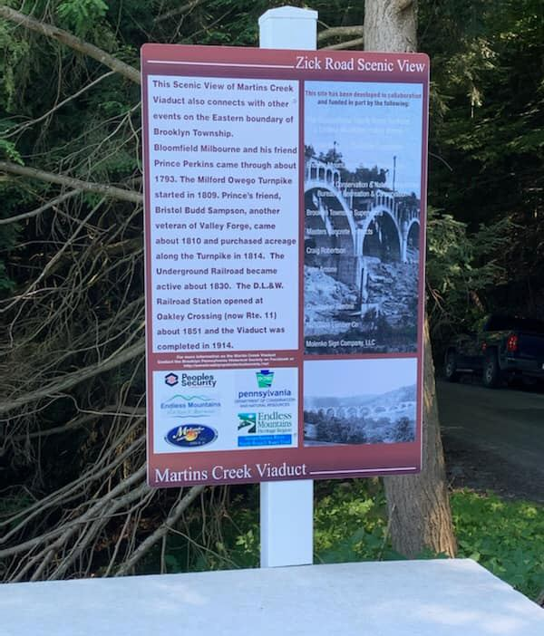
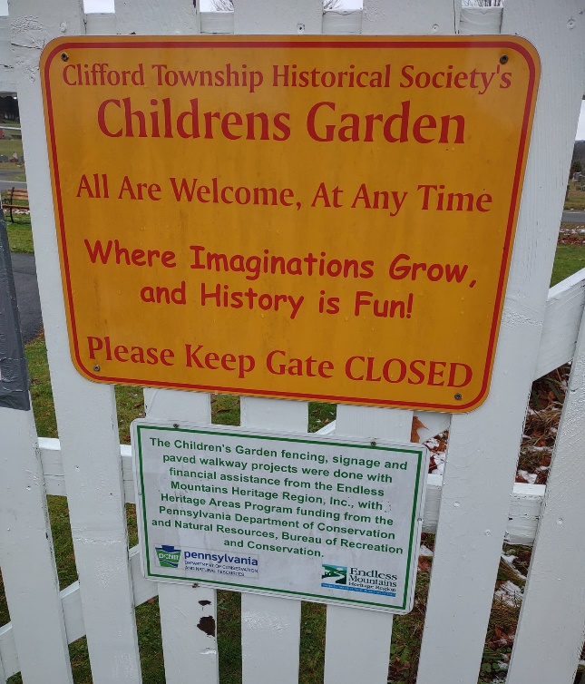
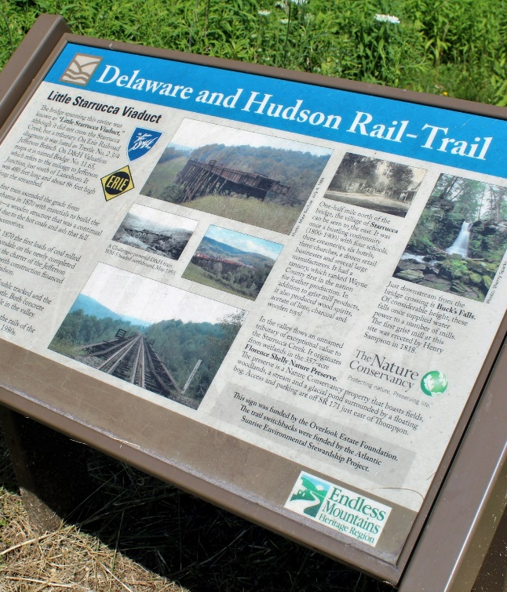
Project Credit
All projects (signage, parks and trails, river access, brochures, exhibits, building improvements, etc.) must include the acknowledgement that they have been funded in part by the EMHR and the DCNR’s Community Conservation and Partnerships Program (C2P2).
Precise language is included in the application/sub-agreement.
This can be accomplished with a plaque or sign at the project site or a simply acknowledgment on brochures or funded materials.

Slide 9
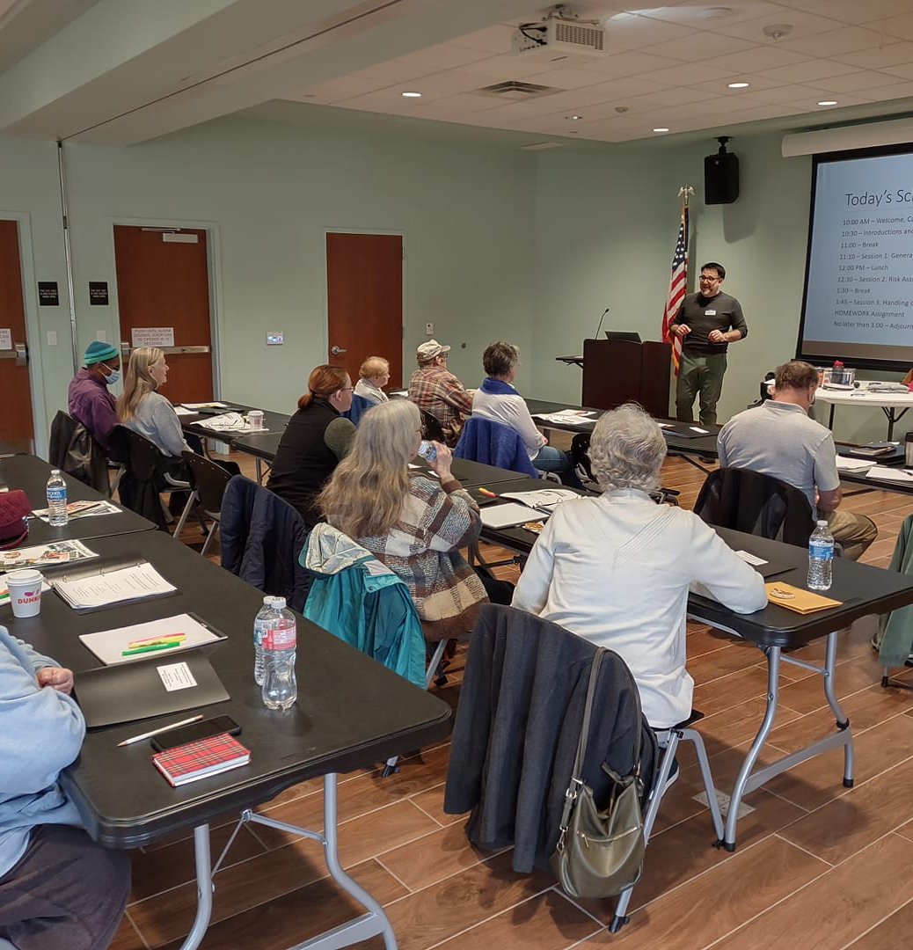
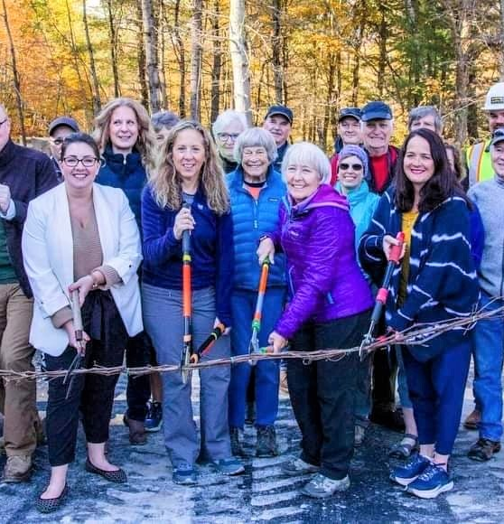
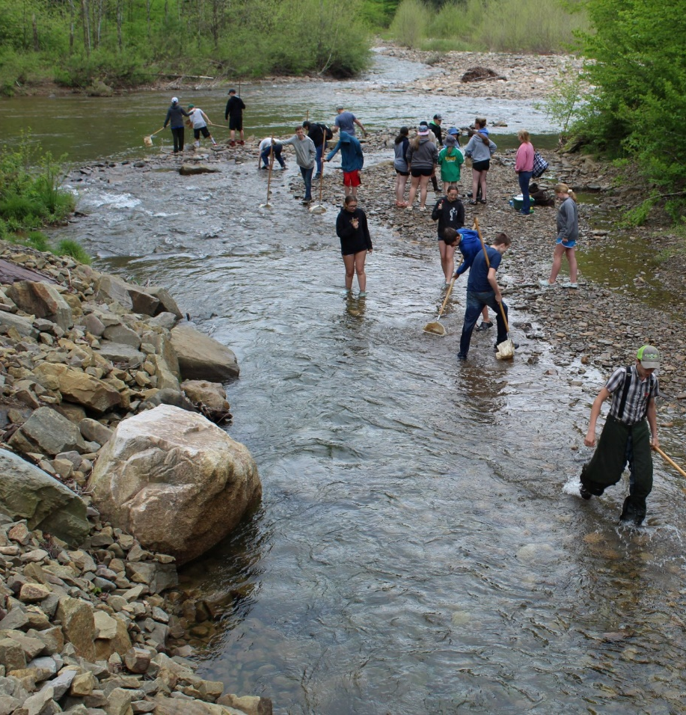
Eligible Reimbursement Costs
Contracted/Professional Costs.
In-House Professional Costs.
Other Project Cash Costs.
Only costs accrued within grant period.

Slide 10
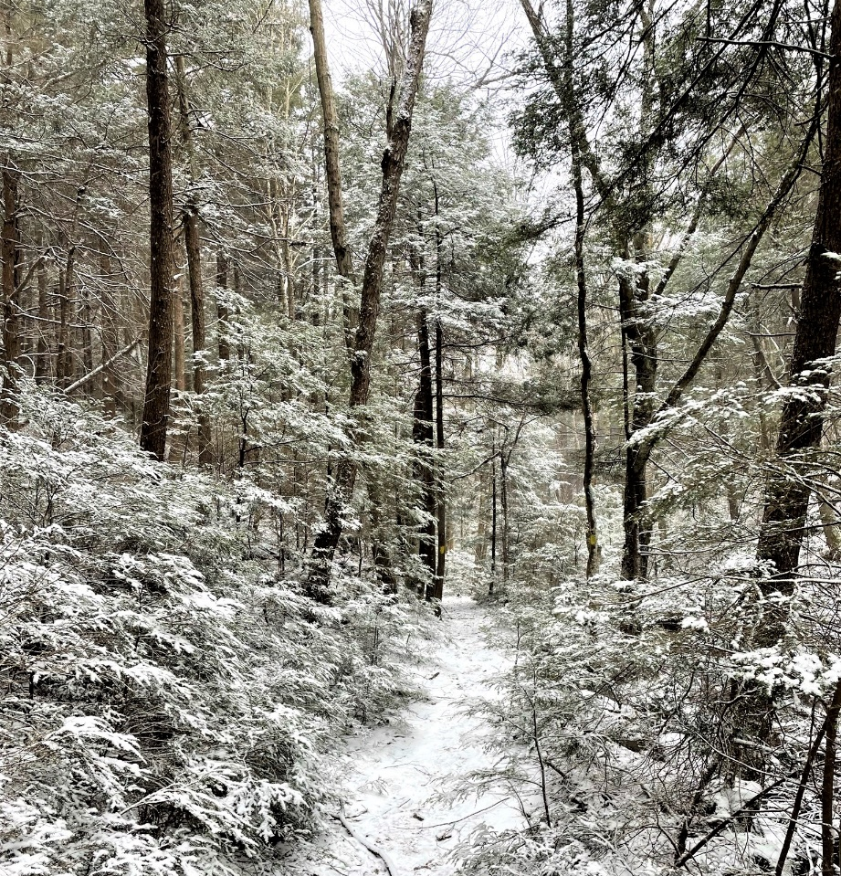
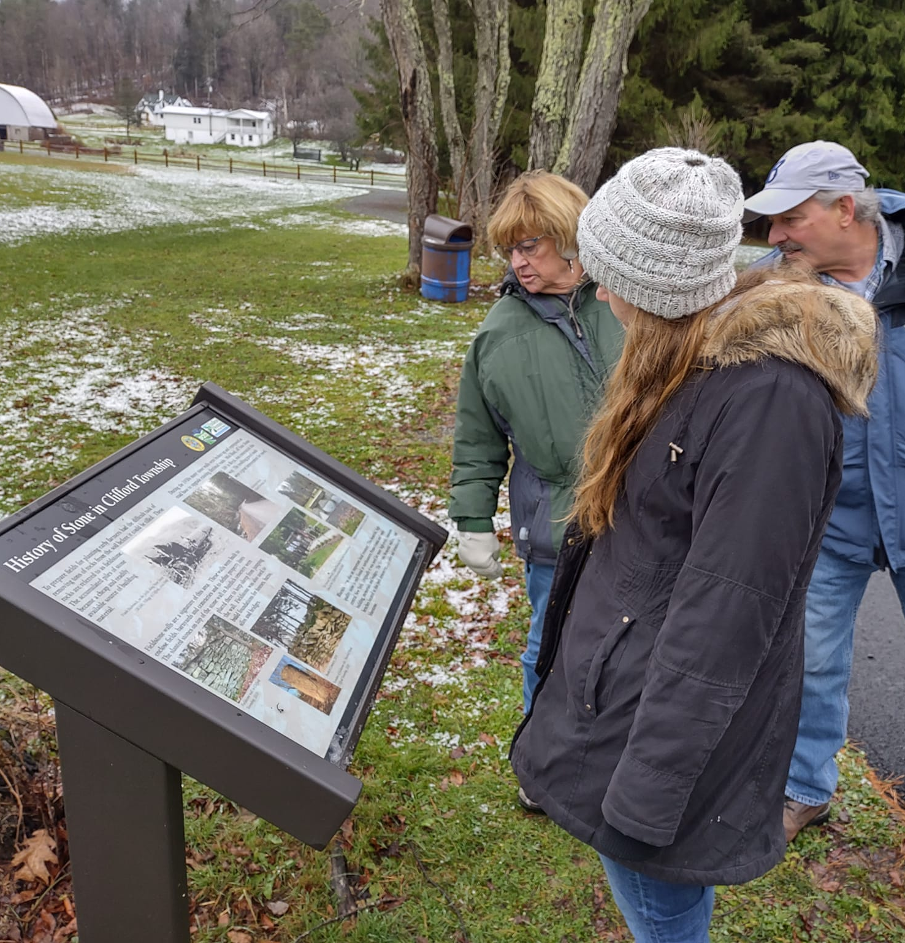
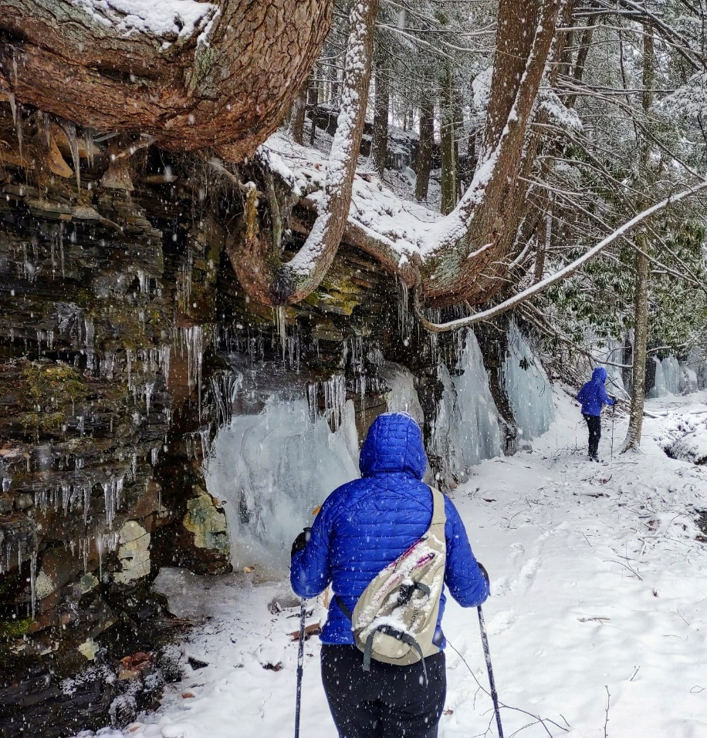
Ineligible Expenditures
Expenses prior to start date of the signed agreement.
Grants/scholarships/fellowships given to third parties.
Indirect costs, general operations of overhead not associated with the project.
Award items, free giveaways, promotional materials.
Equipment.

Slide 11
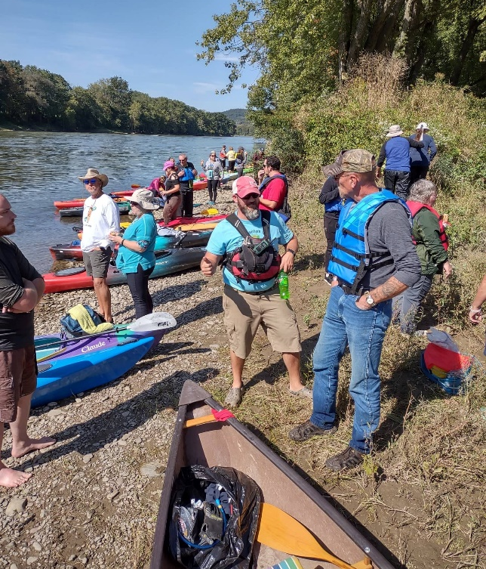
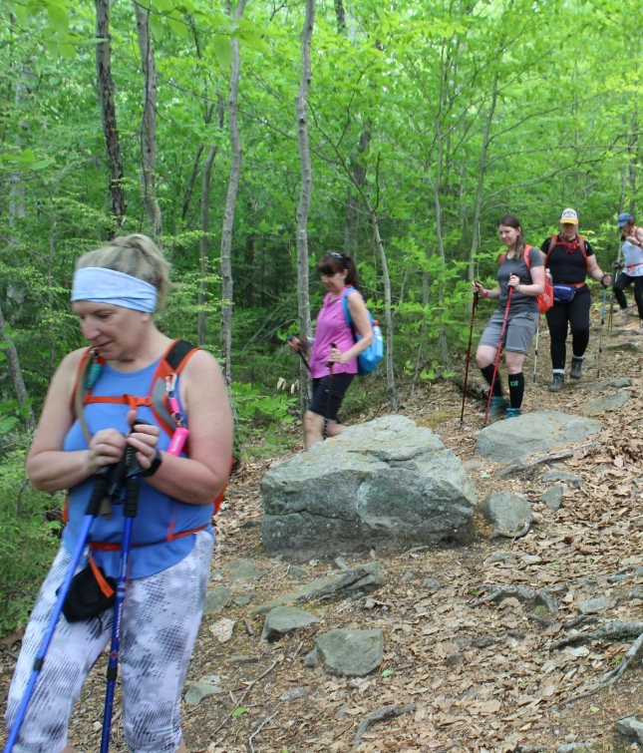
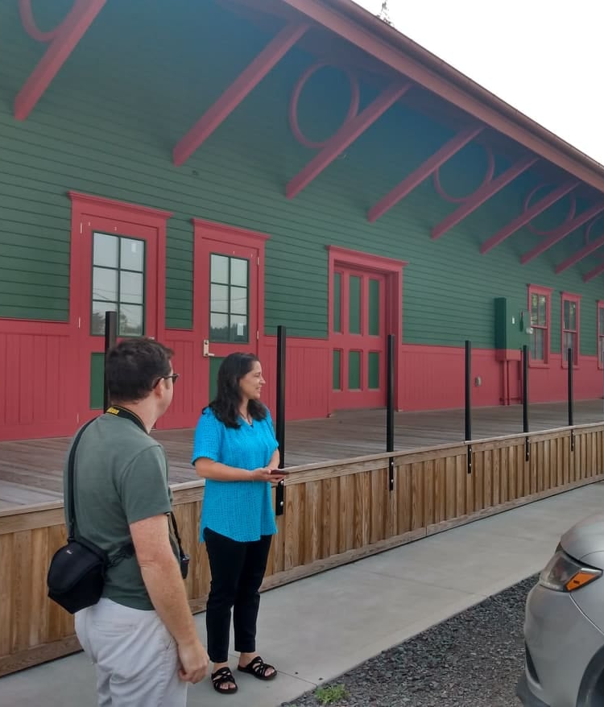
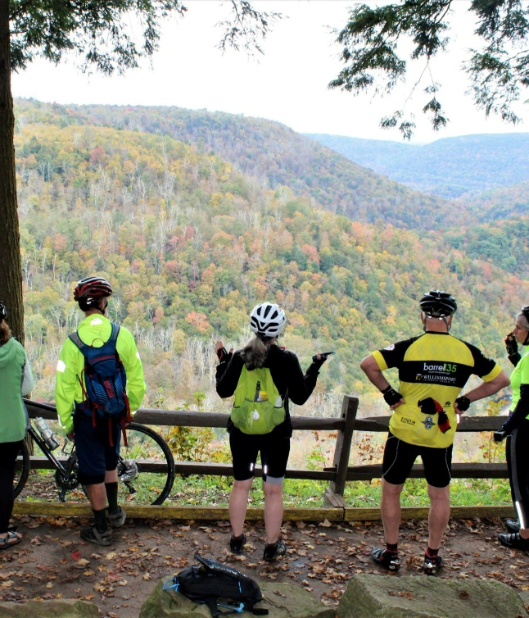
Eligible Forms of Match
Additional Cash Costs.
Contracted/Professional Services.
Volunteer and In-House Professional Services.
Donated Professional Services.
Equipment Use.

Slide 12
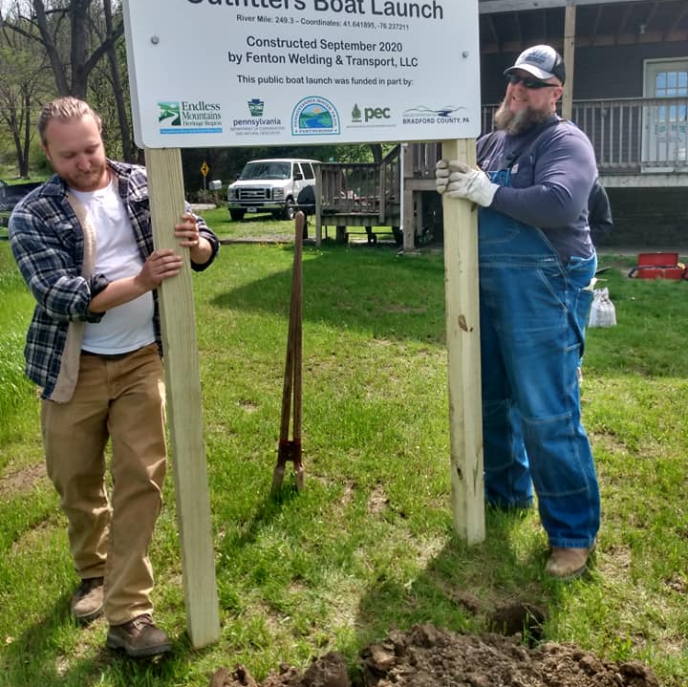
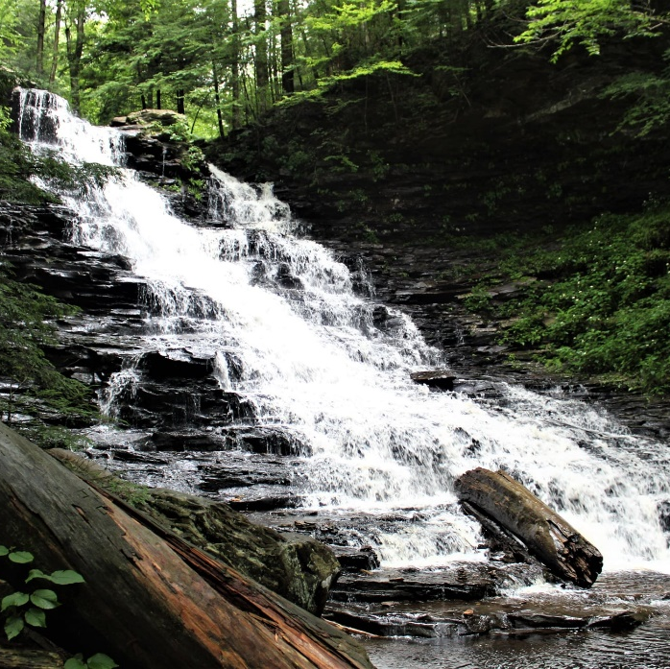
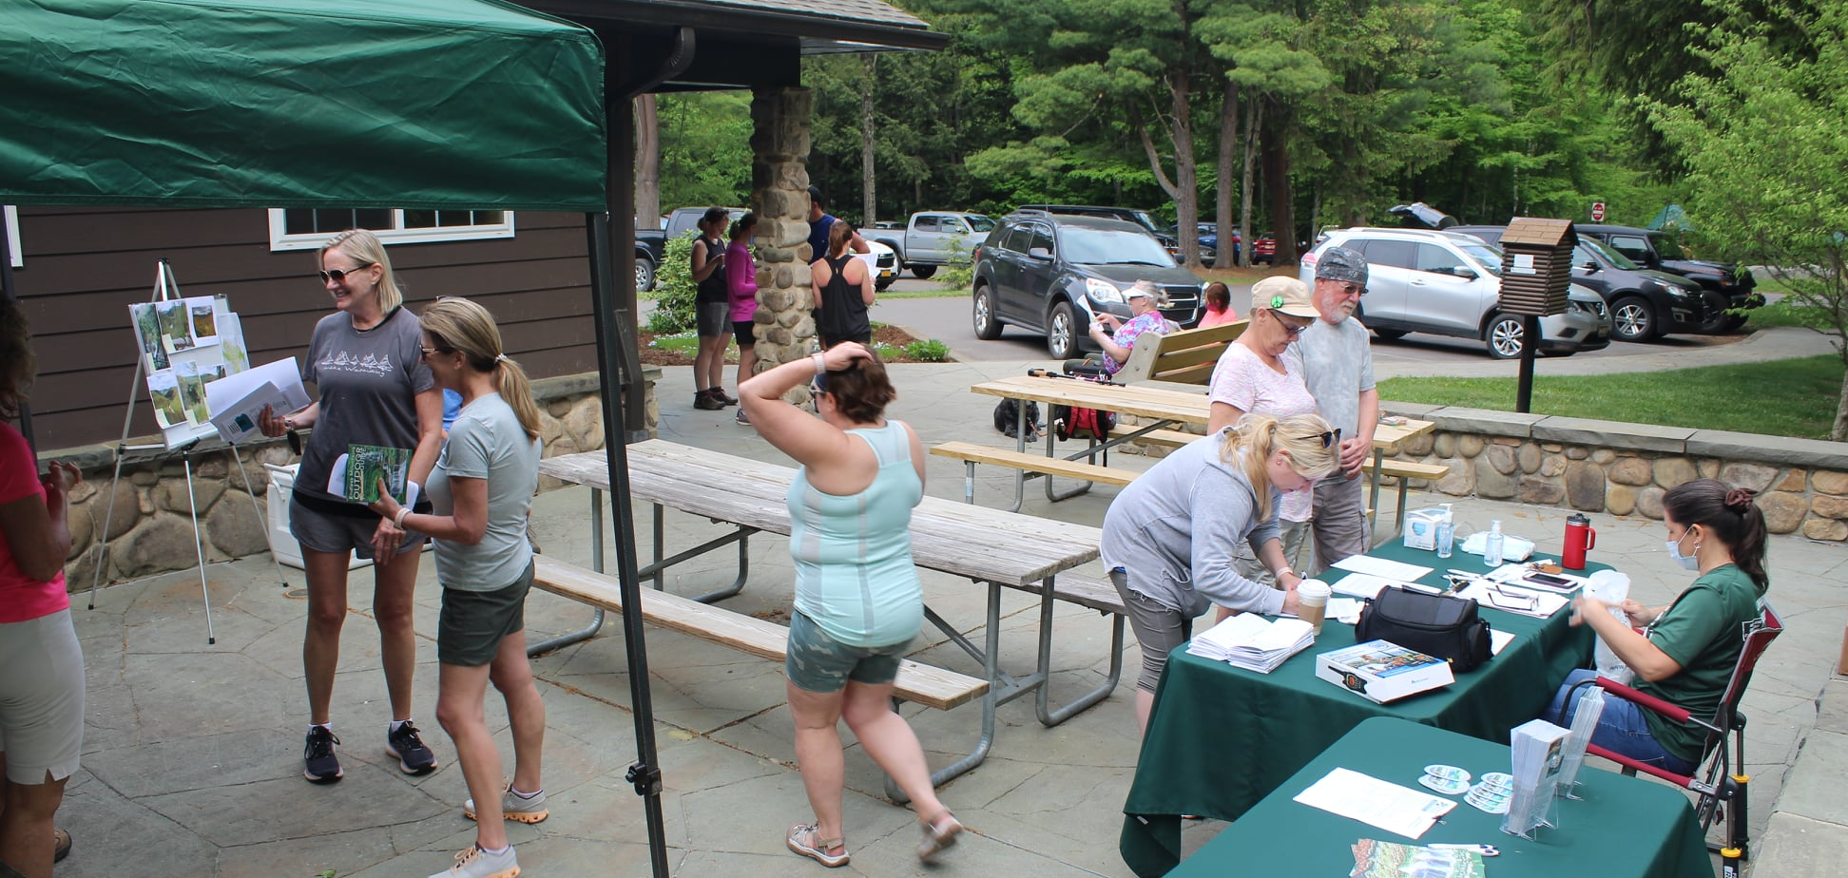
Application Form
Be sure to explain how your project furthers or aligns with the EMHR’s mission/goals (found on Cover Page).
Deliverables or final products from your project should be succinct and measurable.
Examples: The project will produce three interpretive signs to be installed at project site OR two educational workshops held with 15 attendees each.

Slide 13
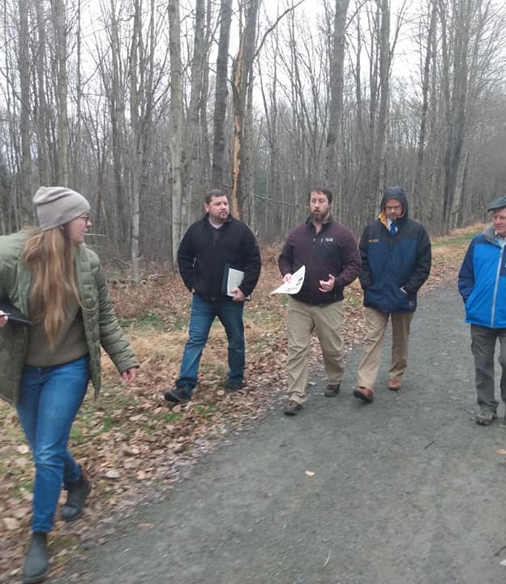
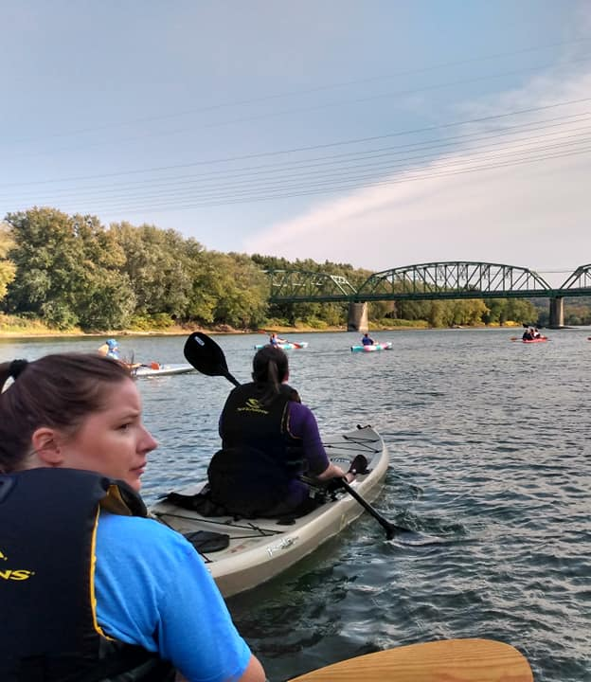
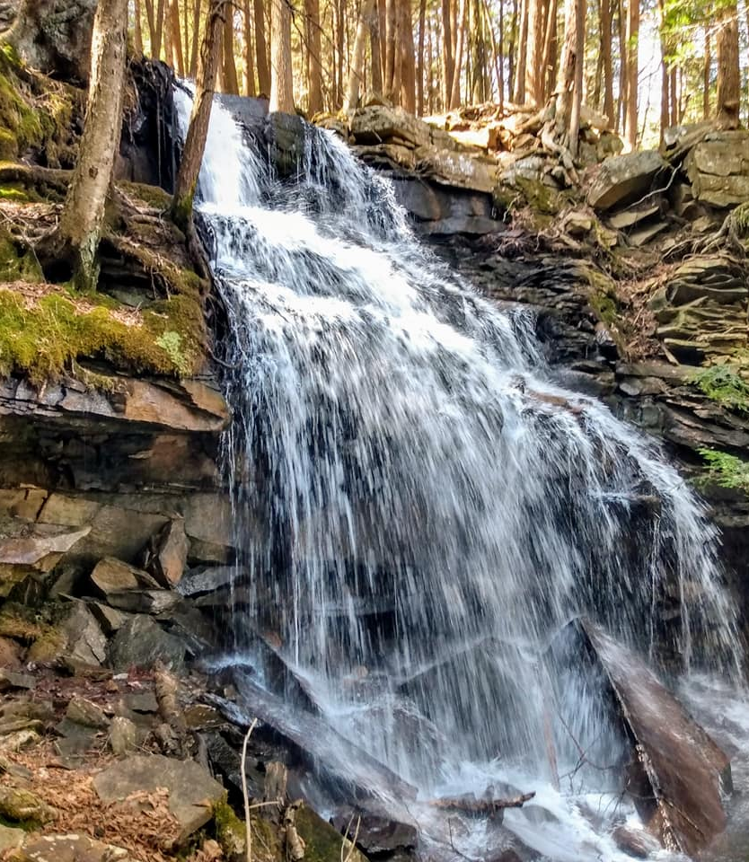
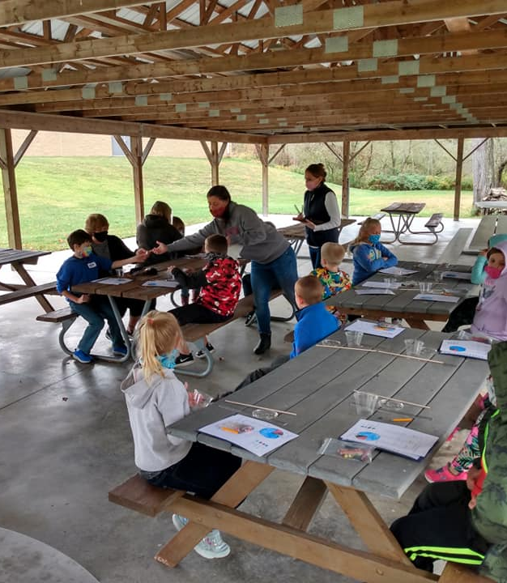
Application Form
List partners committing any type of match (commitment letters).
List partners supporting the project (letters of support).
Show your project can be completed prior to the Sept. 2, 2024 deadline.
Be as specific as possible in the budget section.

Slide 14
Grant Review Committee
Well thought out and adequately explained projects.
Projects to be completed within June 5, 2023 to Sept. 2, 2024 timeframe.
Incorporates partner collaboration.
Applicant experience.
Realistic budget amounts.
Match is identified and secured.
Supports and advances EMHR goals/priorities.

Slide 15
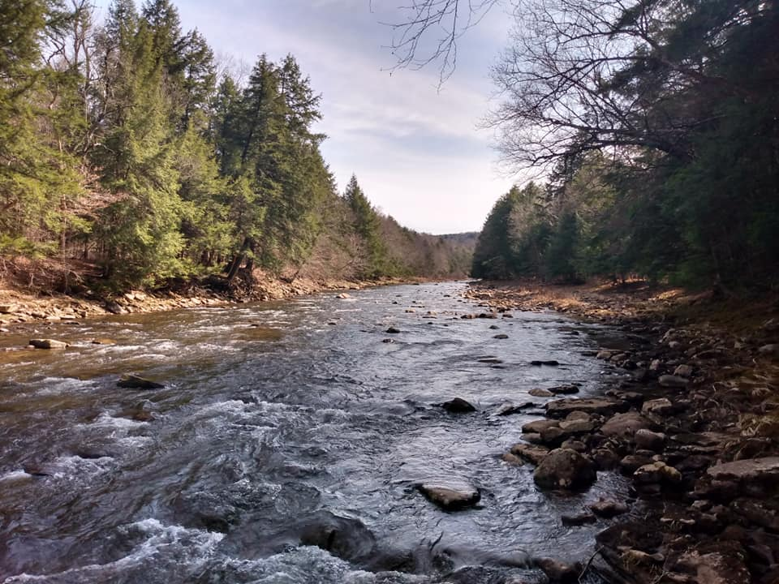
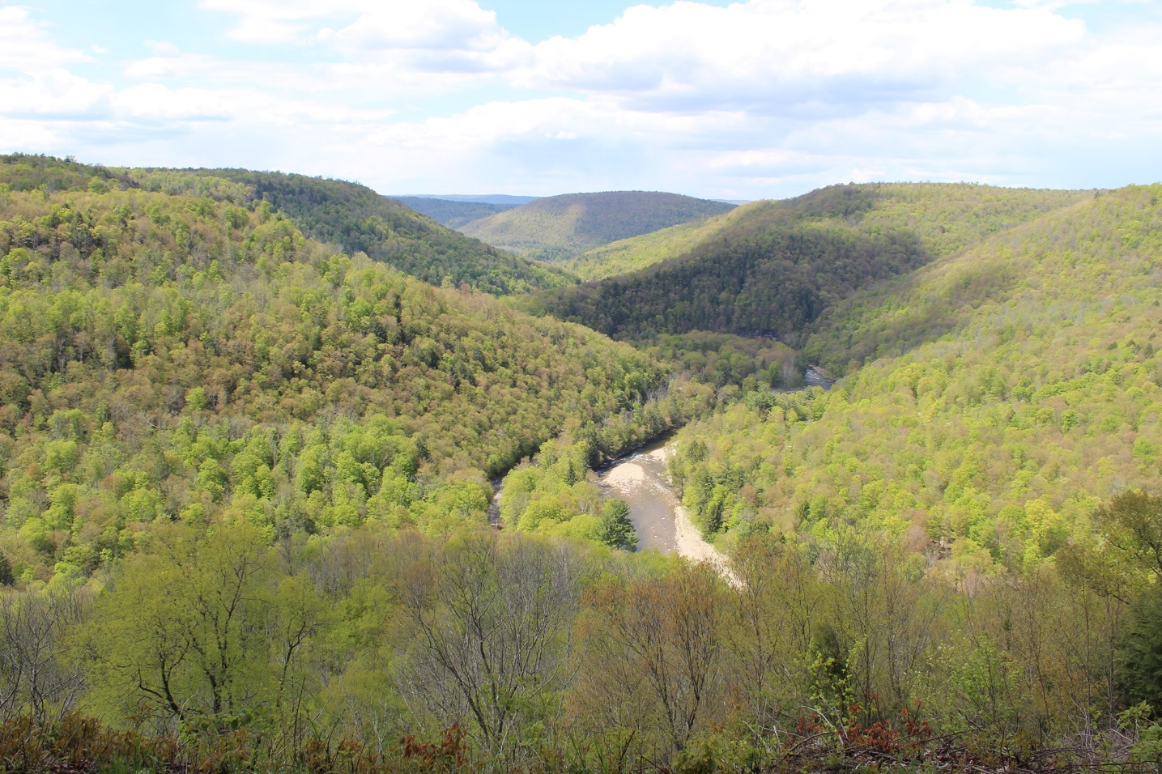
Mini-Grants Timeline
Applications will be accepted beginning Friday, April 7.
Applications are due by 4 p.m. on Monday, May 8.
Awardees to be notified by letter or email no later than May 26, 2022. Public announcements made shortly thereafter.
June 5, 2023 – Sept. 2, 2024 → Project timeline

Slide 16
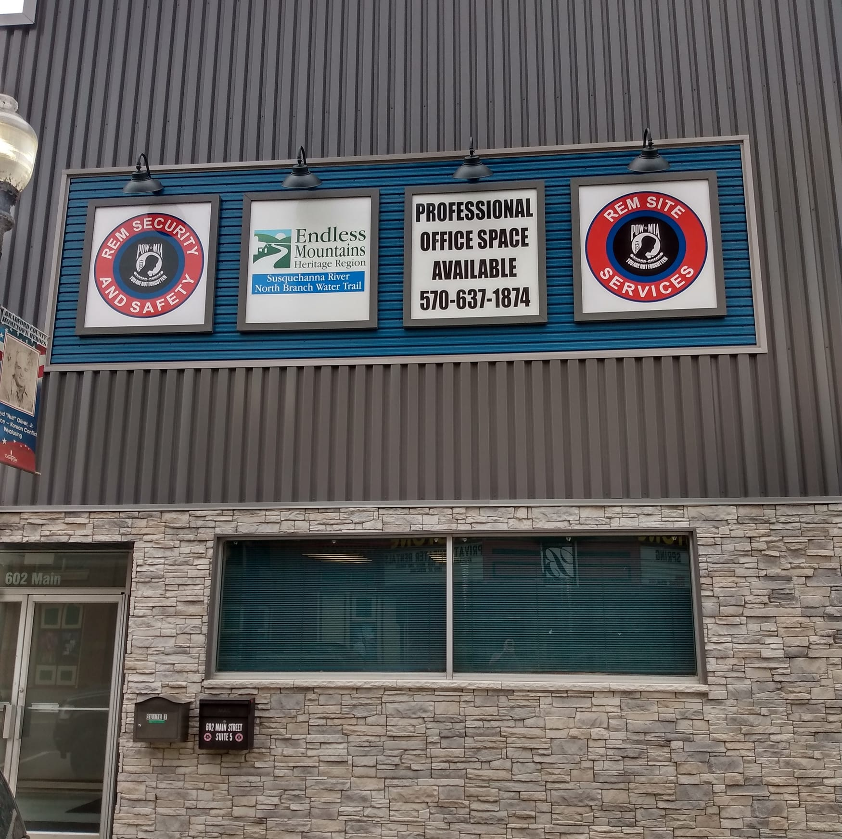
Questions?
For More Information:
Contact@emheritage.org
Or call or send an email to:
570-265-1528
Savannah Schools - sschools@emheritage.org
Vanessa Billings-Seiler - vbillings-seiler@emheritage.org
The EMHR Partnership/Mini-Grants Program has been made
possible through DCNR’s Community Conservation Partnerships
Program (C2P2) and the Environmental Stewardship Fund (ESF).

Slide 17
– Christine Dettore, Northeast Regional Advisor – Dept. of Conservation & Natural Resources
cdettore@pa.gov 610-746-5608 – Paul Macknosky, Regional Director – Dept. of Community & Economic Development
pmacknosky@pa.gov 570-963-4122 – Robyn Cummings, Executive Director – Bradford County Tourism Promotion Agency
bctourism@bradfordco.org 570-265-8687 – Jean Ruhf, Executive Director – Endless Mountains Visitors Bureau
jean@endlessmountains.org 750-836-5431 – Karen Arnold, Keystone Historic Preservation Grant Mgr. – PA Historical & Museum Commission
kaarnold@pa.gov 717-783-9927 – Katie Smith, Economic Development Program Manager – Northern Tier Regional Planning
prichard@northerntier.org 570-265-1532 – Janet Sweeney, Vice President – Pennsylvania Environmental Council
jsweeney@pecpa.org 570-718-1635 – Chris Desrochers, Economic Development Specialist – Progress Authority
chris.cbpa@frontier.com 570-265-0937 – April Hannon, District 4-0 Project Manager – PennDOT
ahannon@pa.gov 570-963-4076 – Cain Chamberlin, Executive Director – Endless Mountains Heritage Region
cchamberlin@emheritage.org 570-265-1528

